Slide 1
Subqueries with the exists Operator
CMPE 2400
Databases

Slide 2
Subqueries
A subquery is a query that is nested within a parent query.
  The key to writing a proper subquery is to remember what is expected by the parent query in the spot in which the subquery is placed.
    For example, if a subquery is to be included in a select list, the subquery must produce exactly one result, or the parent query will cease up.
    Also make sure to remember that data types can also be mismatched even if the number of records returned by the subquery is acceptable.

Slide 3
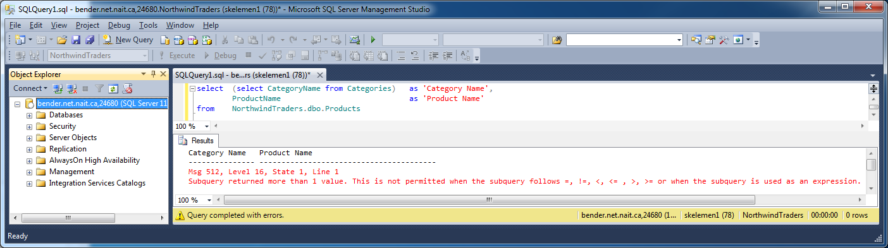
Subqueries
Busted on number of records mismatch.

Slide 4
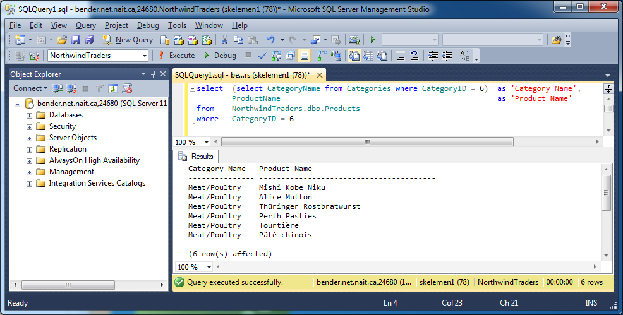
Subqueries
This one is contrived but at least it works…

Slide 5
Filtering with Subqueries
Using a subquery is one way in which two entities in the database may interact.
  The results of a query which interrogates one entity, or table, may be used to filter the results obtained by querying a second entity from which we are actually interested in retrieving information.

Slide 6
Filtering using exists Subqueries
The exists operator is a Boolean operator that tests for the existence of at least one record from the contained subquery.
  Consider the existence check provided to you for detecting whether a procedure has already been created once before.
exists is often more efficient to use than in
  Consider the operation of exists to be similar to a nested for loop in C#. Each parent query table record is sequentially compared to the child query table records, with a true returned on the first match.

Slide 7
Filtering using exists Subqueries
exists is often more efficient to use than in
  Consider the operation of exists to be similar to a nested for loop in C# with use of the continue keyword within an equality comparison in the inner loop .
    Each parent query table record is sequentially compared to the child query table records, with a true returned on the first match of comparison conditions in the child query where clause.

Slide 8
Filtering using exists Subqueries
In the following example, the information from the parent query is used in the subquery
  The subquery results are based on the information from the current row of the parent query
The child select can see the parent select information
The parent select can only see the results of the child select, but not the individual column values
  You may look upon this behavior as somewhat akin to scoping in C#. Any variables created in a scope are local to that scope and are invisible to any encapsulating scopes.

Slide 9
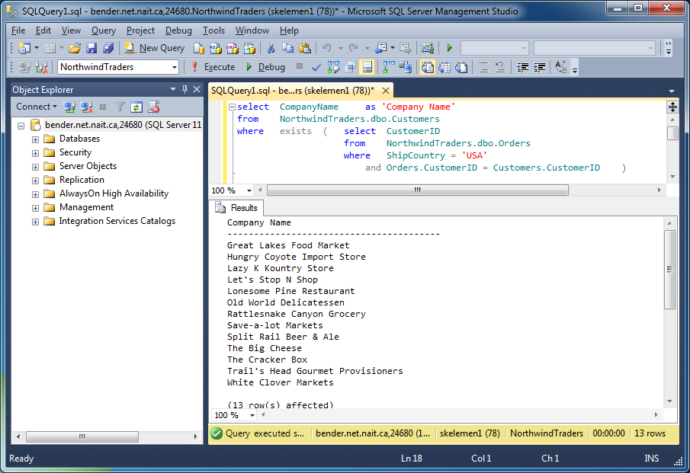
Filtering using exists Subqueries
Provide a list of company names in the USA who have made orders.

Slide 10
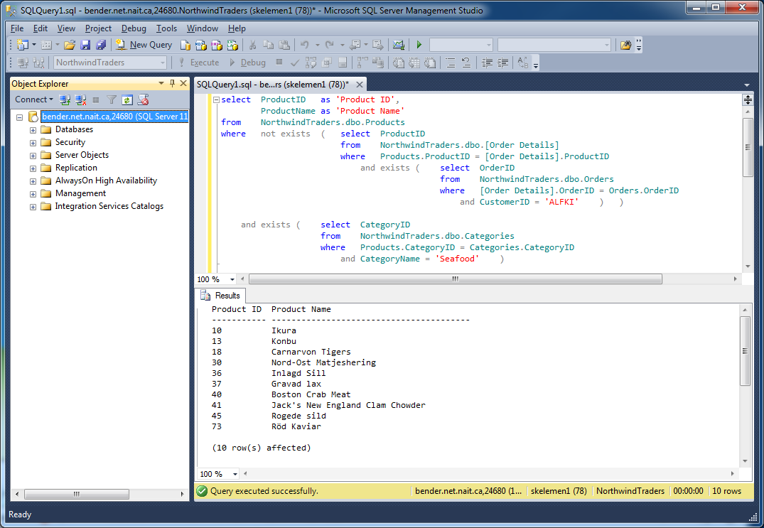
Filtering using exists Subqueries
Retrieve a list of seafood products that have never been sold to the company with a customer ID of ALFKI.

